Slide 1

HCI - Assignment n.2
Design and prototyping of an application using a human-centered approach
Final presentation and demo
Project Title: Aveiro Scholar’s Tavern
Group: Bruno Gomes, Alexandre Martins, João Gonçalves
Lab Class: P3
HCI 2020-2021

Slide 2
Introduction
Aveiro Scholar’s Tavern
Contextualization and motivation:
Meeting the demand for a platform where students can obtain study materials to improve their grades or pass their classes.
The website has a medieval style to cater the attention of students, and to make it easier to implement a gamification system.
Project significance:
Create a platform that fosters learning by rewarding students and tutors with experience points and rewards.
Personal interest:
Combining technology and creativity to incentivize entrepreneurship.
HCI 2020-2021
2
Notes:
These first slides are a recap of the first presentation and should be presented without much detail

Slide 3
Project Objectives
Aveiro Scholar’s Tavern
Our high-level goals:
Create collaboration among users;
Offer a wide range of study materials;
Facilitate the exchange of those materials;
Create a gamification system, that fosters learning;
Expected outcomes:
User income generated through the sale of study materials;
Collaboration and mutual learning;
Better academic performance;
The benefits:
Business opportunities for users;
Community engagement and networking;
Convenience and flexibility.
HCI 2020-2021
3

Slide 4

Personas
António Morgado
20 years old;
Student of Computer Science at Universidade de Aveiro;
He finds the class of “Computer Architecture I” too difficult, therefore, making him seek for help;
António can’t pay for a private tutor, he wants to contact someone who can provide him with some proper study materials, that will make it easier to pass the class.
HCI 2020-2021
4

Slide 5

Personas
Mário Figueiredo
25 years old;
Currently developing his master’s thesis in cybersecurity at UA;
He’s short of money to pay for his university fees;
Mario is willing to share his Computer Science study notes, to anyone who is willing to pay the price for them, however he does not know where to publish and advertise them.
HCI 2020-2021
5

Slide 6
Scenarios
Scenario 1:
António Morgado, is struggling with the class of “Computer Architecture I”;
He discovers “Aveiro Scholar’s Tavern”, a platform for academic support and finds a post from Mário Figueiredo, advertising study notes about “Computer Architecture I”;
António clicks on the post, checks Mário’s profile and decides to buy his study notes;
António is thankful for Mário's help and leaves a positive review on the site.
HCI 2020-2021
6

Slide 7
Scenarios
Scenario 2:
Mário finds “Aveiro Scholar’s Tavern”, he creates an account;
Then, he clicks on “Start Quest!” button to post an advertisement of his Computer Science notes;
He will fill all the information about the content he is about to post, in the posting form;
The post will be available for any student who is logged in the site.
HCI 2020-2021
7

Slide 8
Tasks
Check Tutor Profile
0
Plan 0:
1-2-3-4 Skip 3 if clicked a tutor name in purchase tutoring page
Open website
Scroll down to purchase tutoring
Press review
button
Click a Tutor name
1
2
3
4
Choose a tutor
2.1
HCI 2020-2021
8

Slide 9
Tasks
0
Purchase Tutoring
Plan 0:
1-2-3-4-5-6 Skip 3 if add to cart was pressed in purchase tutoring
1
2
3
4
5
6
Open website
Scroll down to purchase tutoring
Press Review button
Press add to cart button
Open cart
Add payment info
2.1
5.1
Choose a tutor
Checkout
HCI 2020-2021
9

Slide 10
Tasks
0
Leave a review of purchased tutoring
Plan 0:
1-2-3-4-5 Skip 2 and 3 if tutor was selected in purchase tutoring
1
2
3
4
5
Open website
Click Profile button
Expand order info
Press review button
Add rating and comment
2.1
Select order option from drop down
HCI 2020-2021
10

Slide 11
Tasks
Check profile level
0
Plan 0:
1-2
Open website
Press profile on navbar
1
2
Press user name option
2.1
HCI 2020-2021
11

Slide 12
Tasks
Swap badges on profile
0
Plan 0:
1-2-3-4
Open website
2
3
4
1
Press profile on navbar
Press change badge button
Choose from one of the available badges
2.1
Press user name option
HCI 2020-2021
12

Slide 13
Requirements
Non-functional requirements :
Security
Performance
Scalability
Accessibility
Functional requirements :
User Registration
Study field filter
Search
Profile management
Post advertisement
Payment/Checkout
Wishlist
Orders list
HCI 2020-2021
13

Slide 14
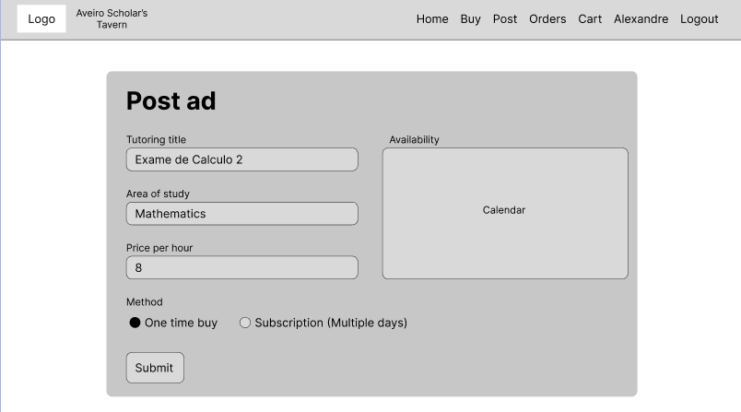
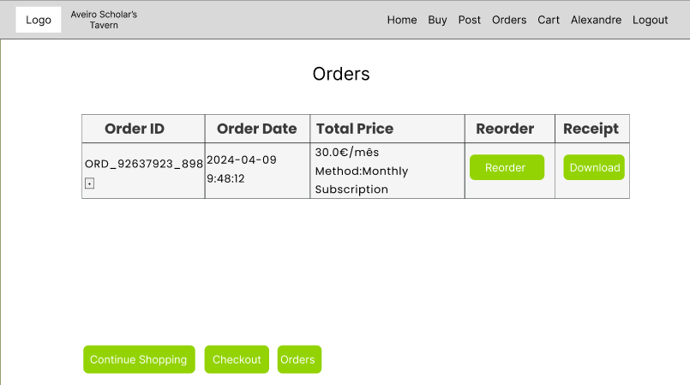
Low Fidelity Prototype (LFP)
Aveiro Scholar’s Tavern
We used the app Figma, to develop our prototype to demonstrate how basic tasks should be performed.
HCI 2020-2021
14
Notes:
This is new material; should be presented in more detail

Slide 15
LFP User Evaluation
Aveiro Scholar’s Tavern
We wanted to evaluate: Usability and ease of use.
Personas: António Morgado and Mário Figueiredo
4 tasks were used: Access tutor profile, post ad, change badge, purchase study materials.
8 participants evaluated our prototype, all of them were students.
Main results:
Accessing the tutor’s profile proved to be hard;
Checkout was cumbersome;
HCI 2020-2021
15

Slide 16





Platform Used for the functional prototype
Aveiro Scholar’s Tavern
Platform built using HTML, CSS and JavaScript;
Flask framework was used to develop our web app;
SQLite3 to create a small database;
Visual Studio Code used as IDE
GitHub was used to control the versions of our project;
HCI 2020-2021
16

Slide 17
User evaluation of the functional prototype
Aveiro Scholar’s Tavern
Task 1: Access tutor’s profile;
Task 2: Buy musical theory study materials;
Task 3: Leave a review about the previously bought content;
Task 4: Check the user’s profile level;
Task 5: Change user’s profile badge.
6 participants
5 students
1 teacher
HCI 2020-2021
17

Slide 18
User evaluation of the functional prototype
Aveiro Scholar’s Tavern
Tasks | 1 | 2 | 3 | 4 | 5 | 6
T1 – Access tutor’s profile | 3 | 3 | 4 | 4 | 4 | 3
T2 – Buy musical theory materials | 4 | 5 | 5 | 5 | 5 | 3
T3 – Leave a review | 3 | 5 | 4 | 4 | 5 | 4
T4 – Check the user’s profile level | 5 | 5 | 5 | 5 | 5 | 3
T5 – Change user’s profile badge | 4 | 5 | 5 | 4 | 5 | 4
HCI 2020-2021
18

Slide 19
Heuristic Evaluation
Aveiro Scholar’s Tavern
Problem | Heuristic | Severity
Accessing tutor’s profile is not clear | 6 | 3
User should be able to review the service in the checkout area | 7 | 2
Badges pop-up should disappear after selecting a badge. | 1 | 2
Mixing wishlist with cart | 8 | 1
Issues 1,2 and 3 were fixed in the final version of the project.
HCI 2020-2021
19

Slide 20
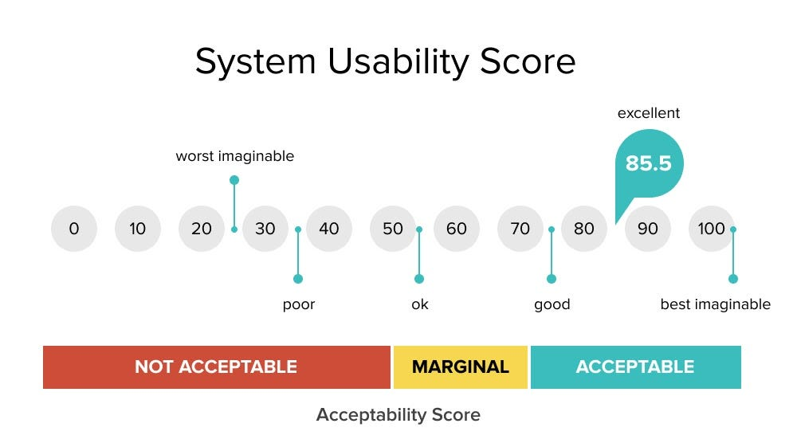
System Usability Scale
Aveiro Scholar’s Tavern
(( 25 + 33 +35 + 35 + 39) * 2.5)/5 = 83.5
According to our calculations, we can say that we obtained an acceptable usability score.
HCI 2020-2021
20

Slide 21
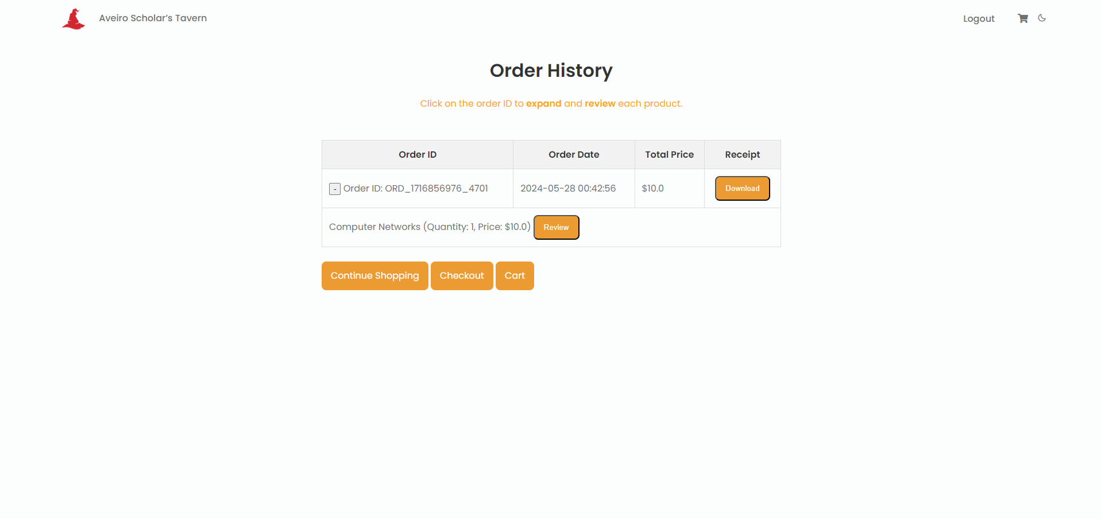
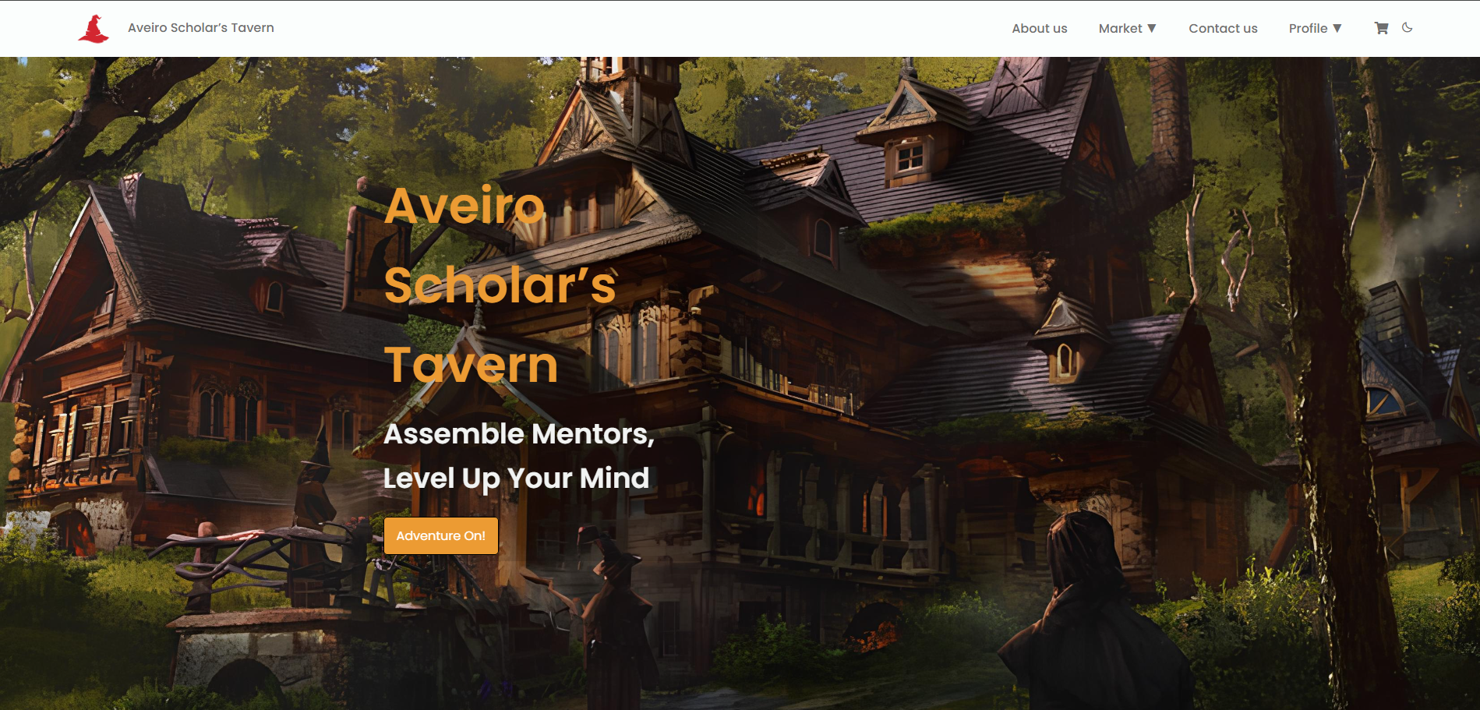
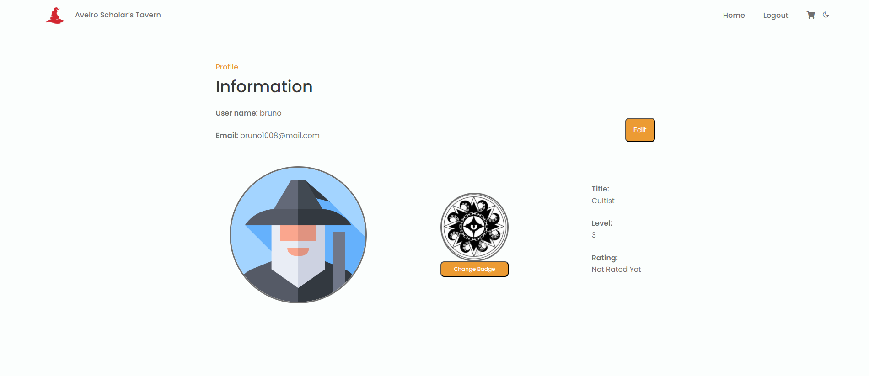
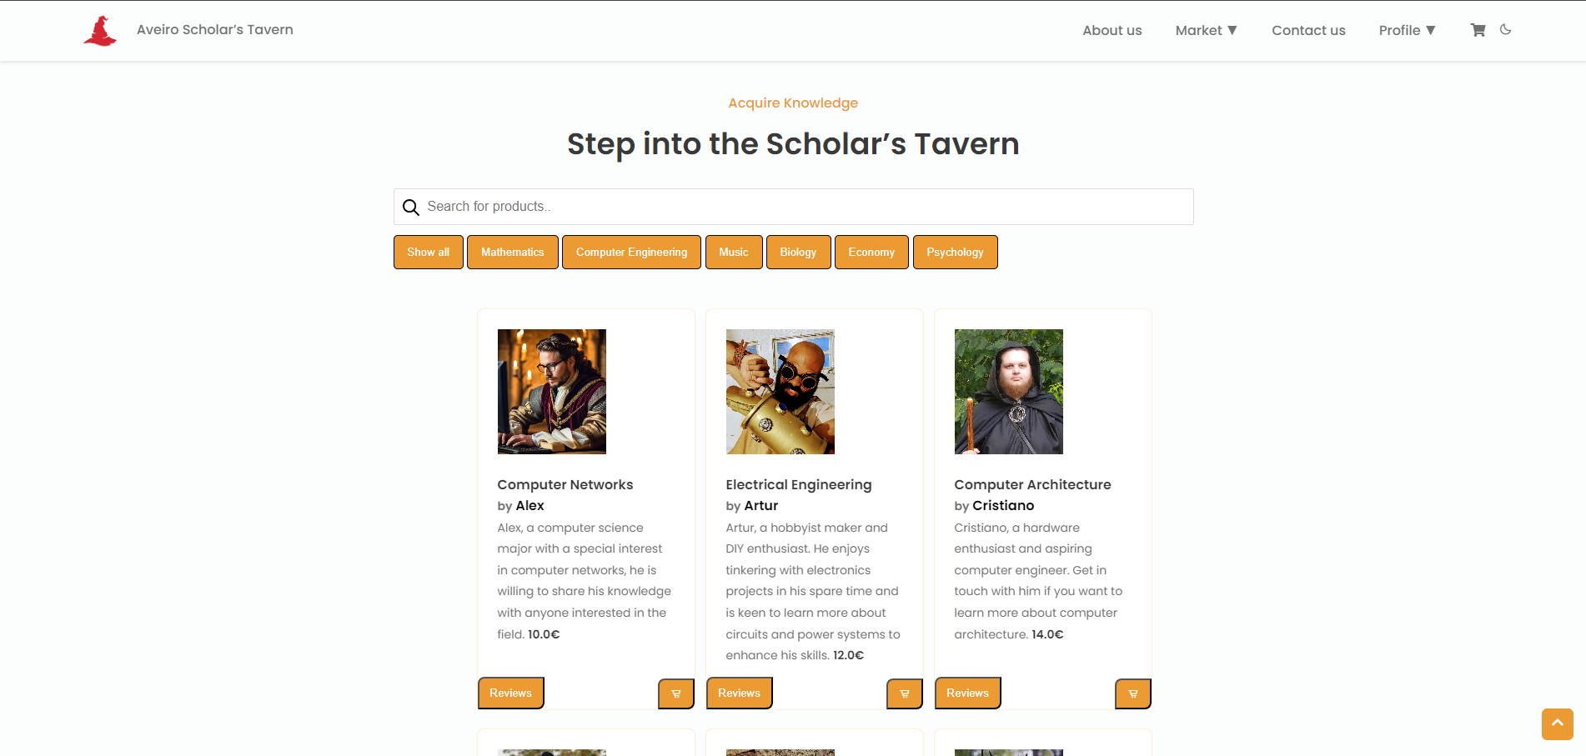
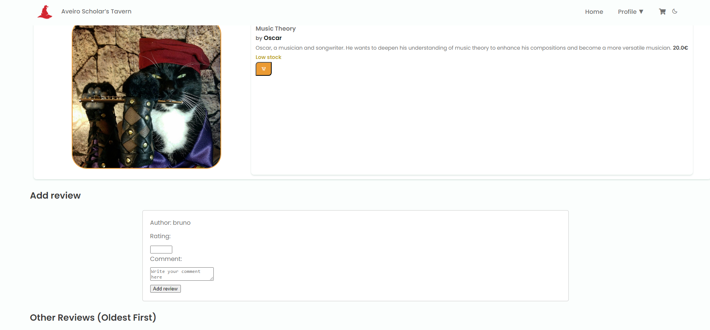
Demo
Aveiro Scholar’s Tavern
HCI 2020-2021
21

Slide 22
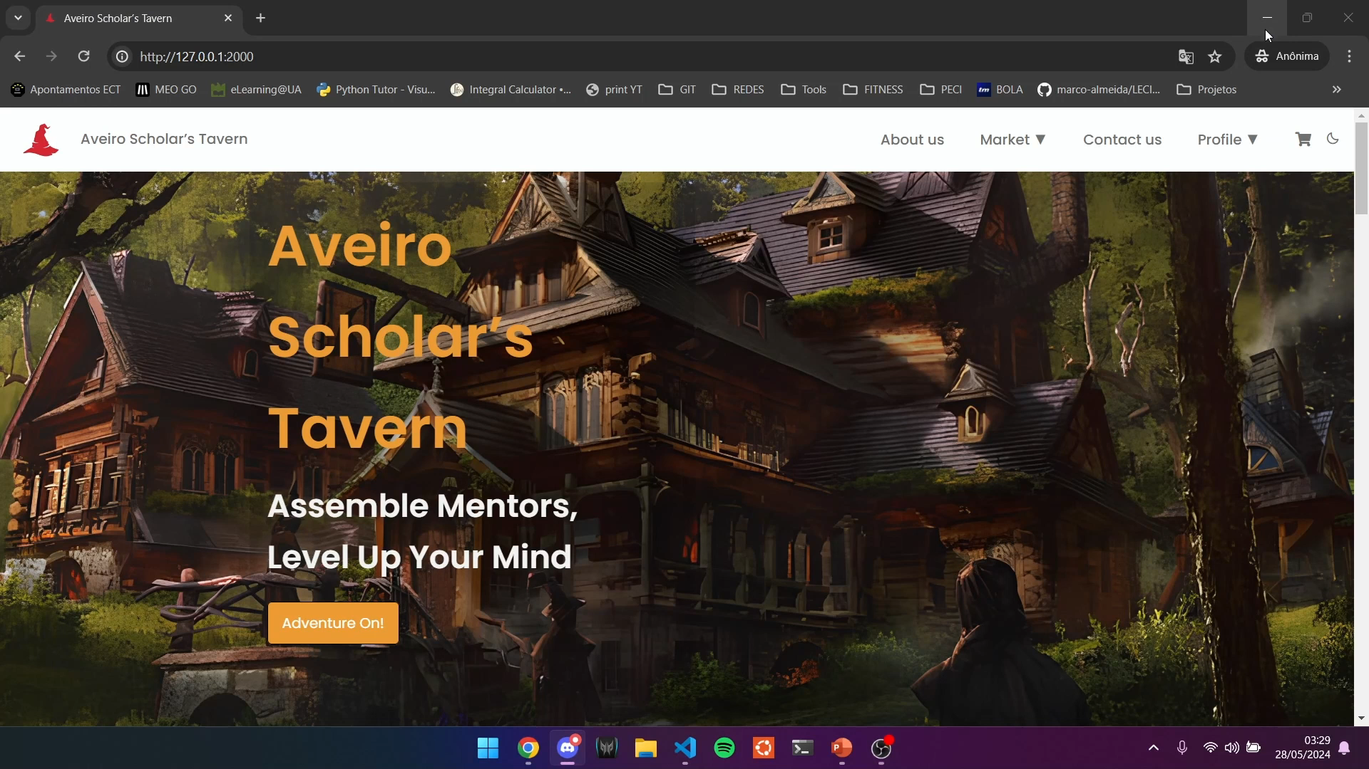
Demo
HCI 2020-2021
22

Slide 23
Future work
Implementation of posting tutoring
Tier for badges that easily identify the user level (bronze, silver, gold, platinum, etc…)
Experience tracking when selling tutorings (gamification)
Effort of each group member
Alexandre Martins – 1/3
Bruno Gomes – 1/3
João Gonçalves – 1/3
HCI 2020-2021
23

